Slide 1

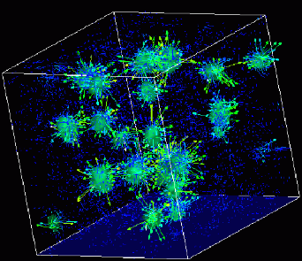

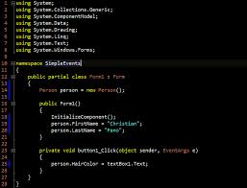
Advanced
Scientific Computing
(SciComp 201)
Session 22
Numerical Integration

Slide 2
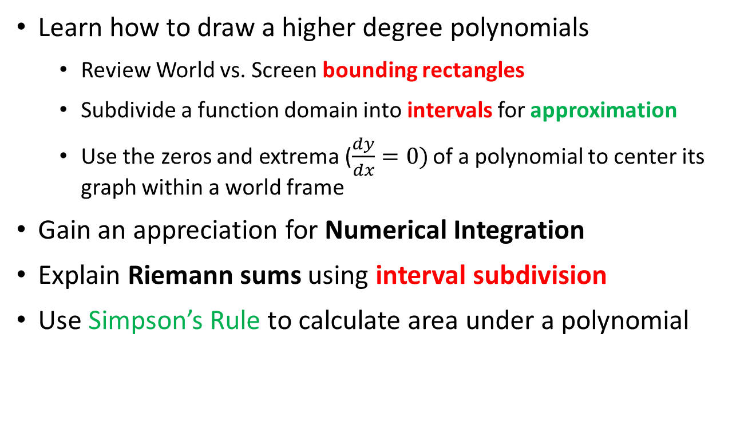
Session Goals
Learn how to draw a higher degree polynomials
Review World vs. Screen bounding rectangles
Subdivide a function domain into intervals for approximation
Use the zeros and extrema ($\frac{dy}{dx}=0)$ of a polynomial to center its graph within a world frame
Gain an appreciation for Numerical Integration
Explain Riemann sums using interval subdivision
Use Simpson’s Rule to calculate area under a polynomial

Slide 3
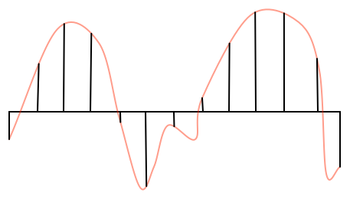
Drawing Curves using Intervals
deltaX
We draw a curve by breaking it into small intervals of straight lines

Slide 4
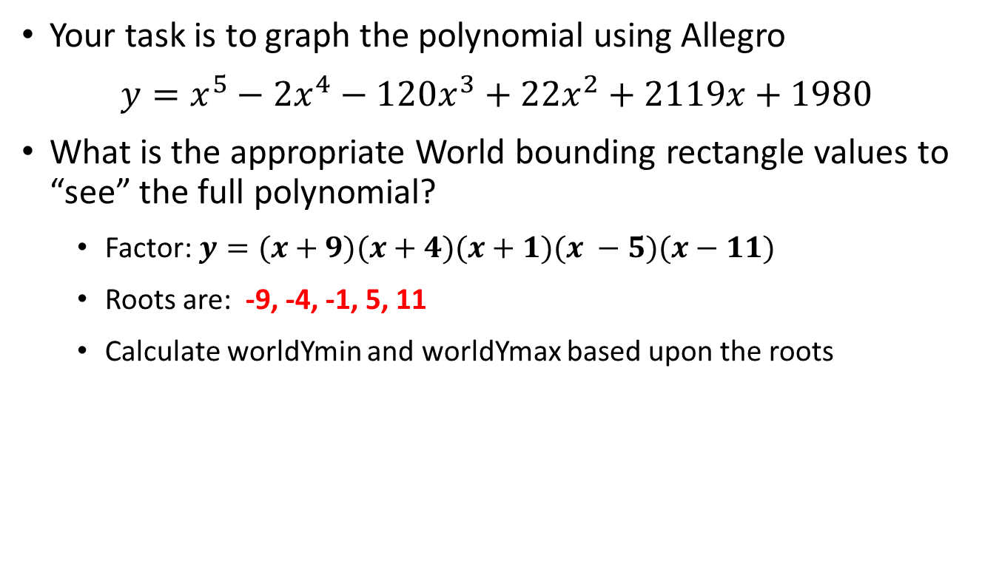
Lab 1 – Draw Polynomial
Your task is to graph the polynomial using Allegro
$y=x^{5}−{2x}^{4}−120x^{3}+22x^{2}+2119x+1980$
What is the appropriate World bounding rectangle values to “see” the full polynomial?
Factor: $y=(x+9)(x+4)(x+1)(x −5)(x−11)$
Roots are: -9, -4, -1, 5, 11
Calculate worldYmin and worldYmax based upon the roots

Slide 5
Lab 1 – Draw Polynomial
$$\frac{dy}{dx}=5x^{4}−8x^{3}−360x^{2}+44x+2119$$

Slide 6
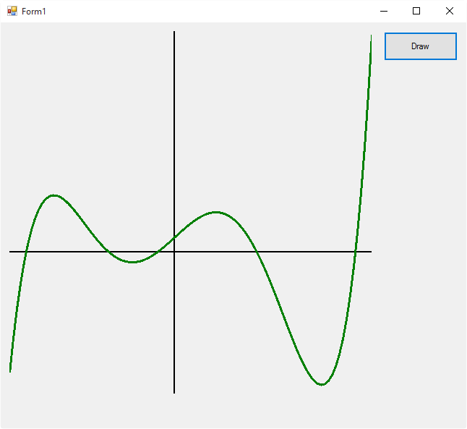
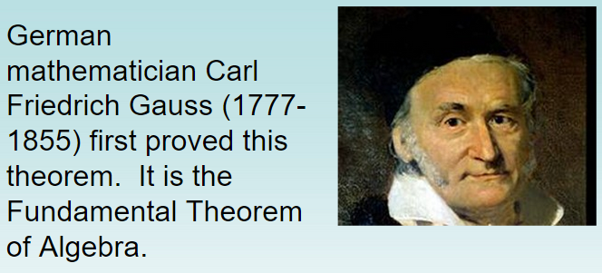
Lab 1 – Draw Polynomial

Slide 7
Why do we need integrals?
How to calculate the total change in a variable X
When variable X depends on the changes in variable Y…
… and variable Y depends on the changes in variable Z…
… and variable Z is constantly changing…
Think about an accelerating car and the total distance it will travel in a given number of seconds
The total distance depends on the velocity of the car…
… the velocity of the car depends on the acceleration
… and the acceleration is constantly changing

Slide 8
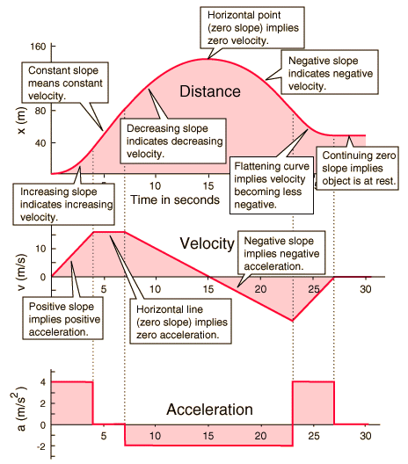
Why do we need integrals?

Slide 9
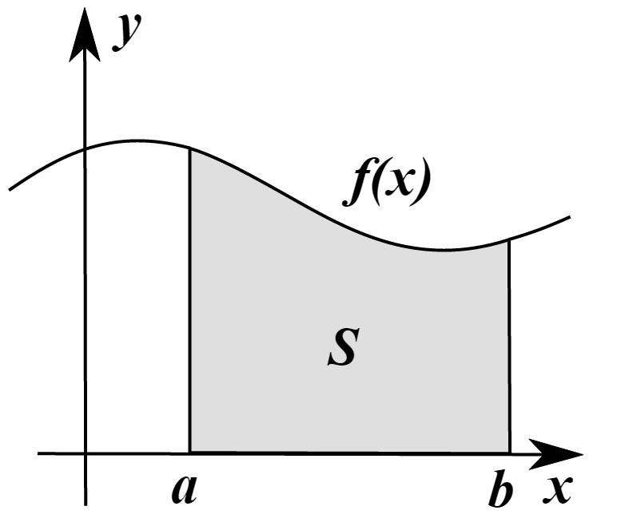
Why do we need integrals?
The integral of a function can be defined as the area under a curve f(x) within the region [a,b]
There are ways to often determine exactly the value of the integral of f(x) – which we would write F(x)
However, sometimes it is not possible to find an analytic expression for F(x) – so we use numerical integration

Slide 10
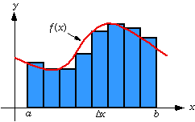
Riemann Sums
One way we can integrate f(x) is to divide the area under the curve into strips (intervals) and sum the area of each strip
This estimate may not be totally accurate because we might have gaps between the true value of f(x) and the top of a strip

Slide 11
Riemann Sums
The width of each strip is $Δx= \frac{(b−a)}{\# of intervals}$
We can minimize the gaps by increasing the number of intervals, which makes $Δx$ get smaller
There are different strategies for determine the shape and height of each strip
Trapezoids
Midpoints
Parabolas (Simpson’s Rule)
Depending upon the particular shape of f(x), one method might be more accurate than the other two

Slide 12
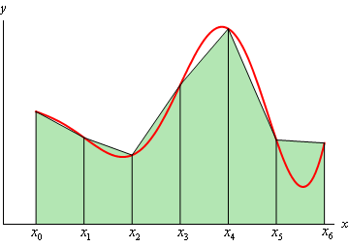
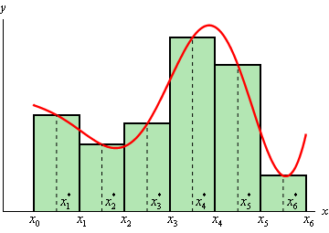
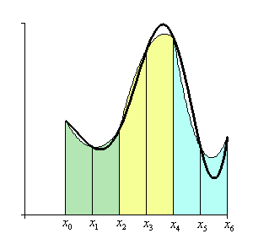
Riemann Sums
Trapezoids
Midpoints
Parabolas
(Simpson’s Rule)

Slide 13
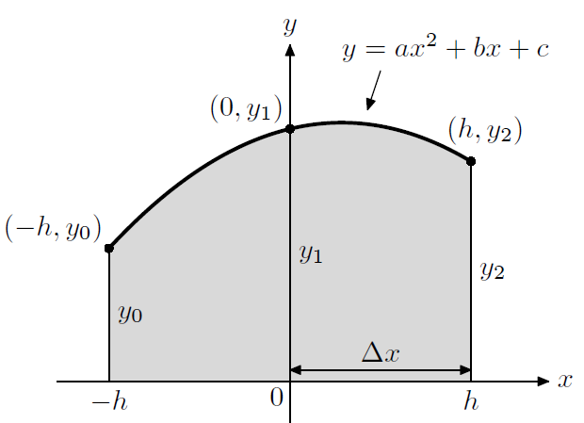
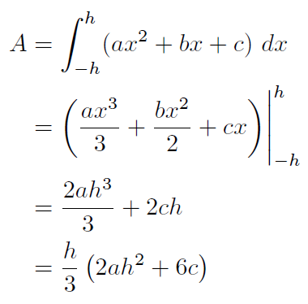

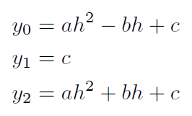
Simpson’s Rule is more accurate!

Slide 14
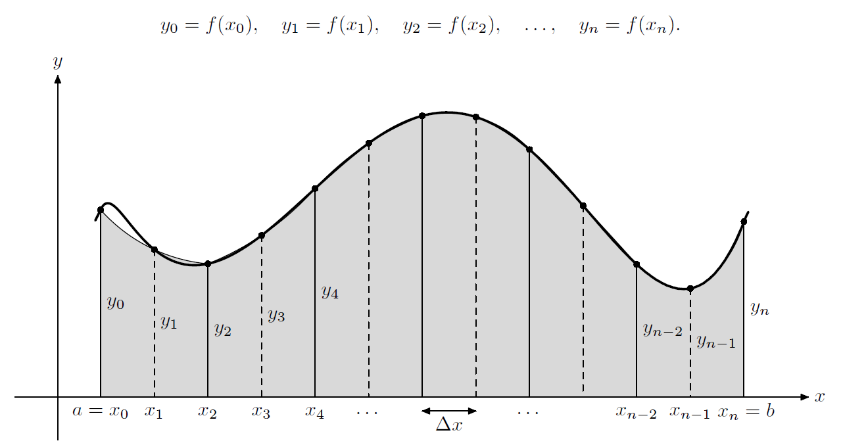

Simpson’s Rule is more accurate!

Slide 15
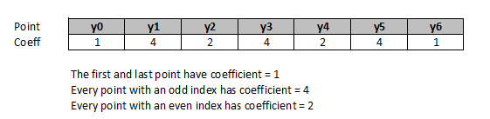
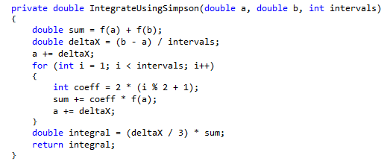
Simpson’s Rule is more accurate!

Slide 16
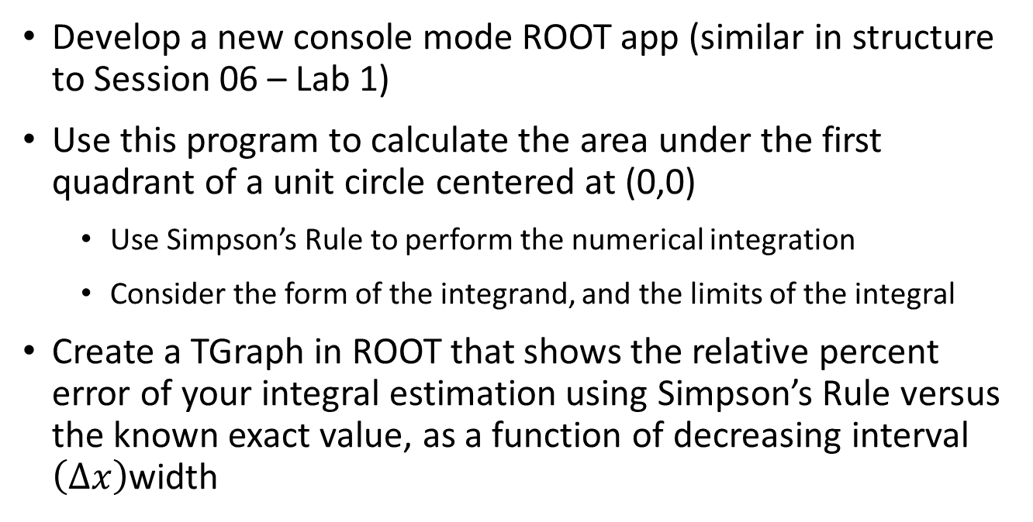
Lab 2 – Simpson’s Rule
Develop a new console mode ROOT app (similar in structure to Session 06 – Lab 1)
Use this program to calculate the area under the first quadrant of a unit circle centered at (0,0)
Use Simpson’s Rule to perform the numerical integration
Consider the form of the integrand, and the limits of the integral
Create a TGraph in ROOT that shows the relative percent error of your integral estimation using Simpson’s Rule versus the known exact value, as a function of decreasing interval $\left(∆x\right)$width

Slide 17
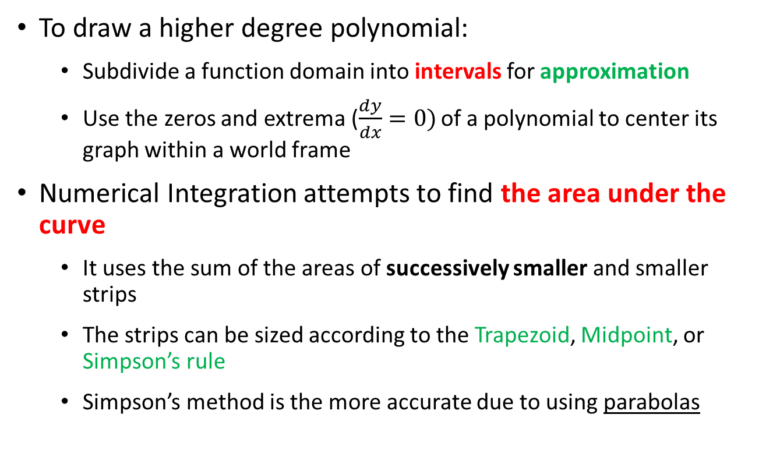
Now you know…
To draw a higher degree polynomial:
Subdivide a function domain into intervals for approximation
Use the zeros and extrema ($\frac{dy}{dx}=0)$ of a polynomial to center its graph within a world frame
Numerical Integration attempts to find the area under the curve
It uses the sum of the areas of successively smaller and smaller strips
The strips can be sized according to the Trapezoid, Midpoint, or Simpson’s rule
Simpson’s method is the more accurate due to using parabolas

